Slide 1
Joint Commission Updates Medical Equipment Standards
Herman A. McKenzie, MBA, CHSP
Director
Department of Engineering
September 28, 2019

Slide 2
Objectives:
Discuss The Joint Commission Mission and Deemed status
Top Survey Findings
Survey Preparation and Documentation
AAMI - Frequently Asked Questions

Slide 3
Mission:
To continuously improve health care
By evaluating health care organizations - meaningful assessment
To provide safe and effective care
Inspiring them to excel

Slide 5
ACO-DSSM-SIG – Like the Government
ACO – Executive
SIG-ENG – Judicial
DSSM – Legislative
Notes:
ACO - Accreditation and Certification Operations
SIG – Standards Interpretation Group
DSSM – Department of Standards and Survey Methods

Slide 6
Survey Types
Full U (Full Unannounced\Triennial)
Med Def (Medicare Deficiency)
SSU/OQPS (Special Survey Unit & Office of Quality and Patient Safety)
ICM 2 or 3 (Intracycle Monitoring)
Extension Survey (New building/services)
Medicare Survey (CLD on Initial)

Slide 7
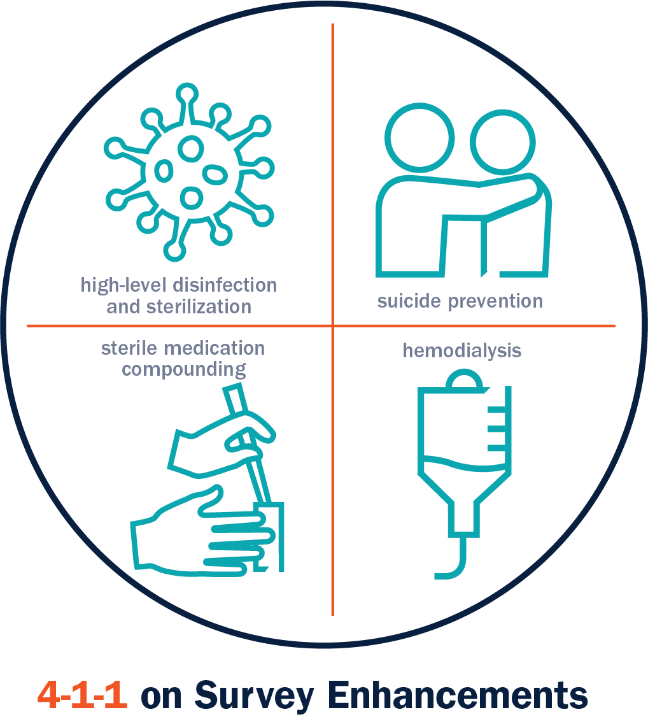
Current and Emerging Patient Safety Risks– An Onsite Survey Focus
High-Level Disinfection/Sterilization
Suicide Prevention
Sterile Compounding
Hemodialysis
Notes:
At The Joint Commission, our mission is to continuously improve health care. With that purpose in mind, I want to call your attention to four high-risk areas on which our surveyors will focus additional attention during your next survey. This increased attention does not involve any new accreditation standards. It does mean that surveyors will be taking a deeper look to identify common opportunities to reduce risk and prevent adverse events related to:

Slide 8
High-Level Disinfection/Sterilization
Failure to comply with HLD and sterilization guidelines have led to numerous outbreaks across the country.
Organizations should have adequate facilities and implement consistent processes regardless of the setting where instruments or equipment are being used or reprocessed.
Surveyors also will evaluate these processes in remote ambulatory settings.
Programs: Hospitals, Critical Access Hospitals, Ambulatory Surgery Centers, Office-Based Surgery
Notes:
Focus on sterilizer maintenance

Slide 9
EC 02.04.03 EP 4 Sterilizers
The hospital conducts performance testing of and maintains all sterilizers. These activities are documented. (See also IC.02.02.01, EP 2)
Notes:
This includes user maintenance activities

Slide 10
Suicide Prevention
Will provide guidance on what constitutes adequate safeguards to prevent suicide, an expert panel has been assembled with representatives from provider organizations, experts in suicide prevention and the design of behavioral health care facilities, Joint Commission surveyors and staff, and representatives from the Centers for Medicare & Medicaid Services (CMS).
Organizations should become familiar with the panel’s recommendations, which now distinguish the requirements for different types of health care facilities and areas within psychiatric units.
Settings: Psychiatric hospitals, psychiatric units within general hospitals, general medical/surgical wards, emergency departments
Notes:
Not in scope of HTM but TJC focus

Slide 11
Sterile Compounding
As seen in recent media reports, despite increased regulations, incidents of contamination continue to occur.
Expect the survey team to spend additional time in evaluating compounding services within your organization, including in remote ambulatory settings.
For home care organizations, the new “Medication Compounding” standards chapter will be utilized to evaluate compliance.
Programs: Hospitals, Critical Access Hospitals, Home Care
Notes:
For healthcare technology professionals our surveyors will focus on hood testing

Slide 12
Hemodialysis
A very technical, high-risk area, care teams must be capable and competent to protect themselves from the risk of needle sticks, blood exposure and other complications of treatment while caring for hemodialysis patients.
Programs: Hospitals, Critical Access Hospitals, Ambulatory
Notes:
Focus is on maintenance or machines, reverse osmosis machines and water used for treatment

Slide 13
EC 02.04.03 EP 5 Hemodialysis
The hospital performs equipment maintenance and chemical and biological testing of water used in hemodialysis. These activities are documented
Notes:
Expired test strips would be scored at this EP

Slide 14
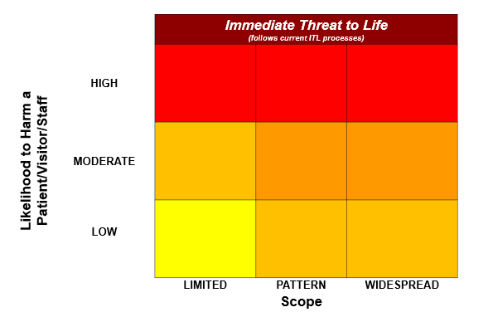
Survey Analysis For Evaluating Risk (SAFER)

Slide 15
Customer Impact
No more Direct and Indirect EP designations
Consolidated Evidence of Standards Compliance (ESC) into one time frame, 60 days
No more Opportunities for Improvement (OFIs), no more ‘A’ and ‘C’ categories
See it/Cite it Survey Methodology

Slide 16
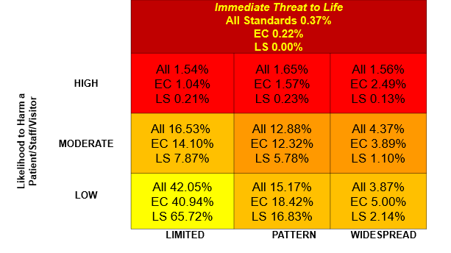
Survey Analysis For Evaluating Risk (SAFER)

Slide 17
Percent of Hospitals With At Least One Condition Level Deficiency
2016
38.7%
2017
49.45%

Slide 18
Top Medical Equipment Findings
The following reflect the top 10 medical equipment observations from January through December 2018
Notes:
EC 02.04.03 EP 27 no longer, this is cited under EC 02.05.01 EP 23 RPT

Slide 19
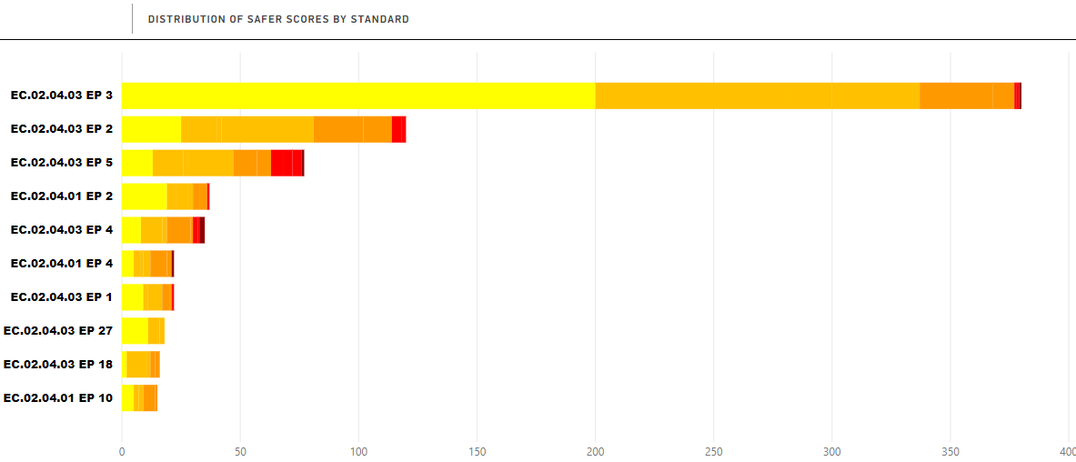
Top 10 Most Frequently Cited Medical Equipment Requirements for Improvements (RFIs)– Hospital Program: 01/01/2018 to 12/31/2018 (n=1465)

Slide 20
Top Ten Eps…#10
EC 02.04.01 EP 10 The hospital identifies quality control and maintenance activities to maintain the quality of the diagnostic computed tomography (CT), positron emission tomography (PET), magnetic resonance imaging (MRI), and nuclear medicine (NM) images produced. The hospital identifies how often these activities should be conducted
During tracer activity in the CT department the surveyor observed missing daily quality control checks.

Slide 21
#9
EC 02.04.03 EP 18 The hospital maintains the quality of the diagnostic computed tomography (CT), positron emission tomography (PET), magnetic resonance imaging (MRI), and nuclear medicine (NM) images produced.
In 3 of 3 years of quality control logs observed in the Radiology CT Control room, the daily quality control, as per the manufacturer's recommendation, was not documented.
Observed in the Radiology MRI Control room, the daily/weekly quality control (QC), as per the manufacturer's recommendation, was not documented. When queried, the MRI tech was not familiar with any QC activities.

Slide 22
#8
EC 02.04.03 EP 27 The hospital meets NFPA 99-2012: Health Care Facilities Code requirements related to electrical equipment in the patient care vicinity. (For full text, refer to NFPA 99-2012: Chapter 10) Note: For hospitals that use Joint Commission accreditation for deemed status purposes: The hospital meets the applicable provisions of the Health Care Facilities Code Tentative Interim Amendment (TIA) 12-5.

Slide 23
#8, Continued
During a tracer in the Emergency Department, it was observed that the staff were not following the manufacturer's instructions for use for the Pedigo blanket warmer. The staff were placing patient gowns with snaps in the blanket warmer. The manufacturer's instructions for use stated: "Pedigo blanket warmers are intended for warming cotton blankets ONLY. No other use for this device is authorized or recommended."

Slide 24
#7
EC 02.04.03 EP 1 For hospitals that do not use Joint Commission accreditation for deemed status purposes: Before initial use of medical equipment on the medical equipment inventory, the hospital performs safety, operational, and functional checks. For hospitals that use Joint Commission accreditation for deemed status purposes: Before initial use and after major repairs or upgrades of medical equipment on the medical equipment inventory, the hospital performs safety, operational, and functional checks.
No documentation was observed to confirm the hospital performed safety, operational, and functional checks for all new medical equipment, prior to initial use.

Slide 25
#6
EC 02.04.01 EP 4 The hospital identifies the activities and associated frequencies, in writing, for maintaining, inspecting, and testing all medical equipment on the inventory. These activities and associated frequencies are in accordance with manufacturers’ recommendations or with strategies of an alternative equipment maintenance (AEM) program. Note 1: The strategies of an AEM program must not reduce the safety of equipment and must be based on accepted standards of practice, such as the American National Standards Institute/Association for the Advancement of Medical Instrumentation handbook ANSI/AAMI EQ56: 2013, Recommended Practice for a Medical Equipment Management Program.

Slide 26
#6, Continued
Note 2: Medical equipment with activities and associated frequencies in accordance with manufacturers’ recommendations must have a 100% completion rate. Note 3: Scheduled maintenance activities for both high-risk and non-high-risk medical equipment in an alternative equipment maintenance (AEM) program inventory must have a 100% completion rate. AEM frequency is determined by the hospital's AEM program.

Slide 27
6, Continued
Observed a nebulizer in a clinic with a pm sticker indicating that this piece of equipment had been risk assessed as requiring an initial check, but no further preventative maintenance. Manufacturer instructions require filter changes every six months. Preventative maintenance staff explained that the risk score did not match manufacturer recommendations because "we do not always follow manufacturer instructions.“ No other justification for lack of maintenance was offered

Slide 28
#5
EC 02.04.03 EP 4 The hospital inspects, tests, and maintains non-high-risk equipment identified on the medical equipment inventory. These activities are documented. Note: Scheduled maintenance activities for non-high-risk medical equipment in an alternative equipment maintenance (AEM) program inventory must have a 100% completion rate. AEM frequency is determined by the hospital’s AEM program.

Slide 29
#5, Continued
During review of the documentation provided of all repairs and Preventive Maintenance performed on the OR autoclave used for IUSS, it was noted that this equipment had not undergone any scheduled preventive maintenance in the last 1-1/2 years. Records showed the autoclaves underwent repairs in 03/2017 and 09/2017 with the last documented PM in 03/2017. The hospital decommissioned the OR autoclave and moved all IUSS to the Sterile Processing Department. (This was an ITL)

Slide 30
#4
EC 02.04.01 EP 2 For hospitals that do not use Joint Commission accreditation for deemed status purposes: The hospital maintains either a written inventory of all medical equipment or a written inventory of selected equipment categorized by physical risk associated with use (including all life-support equipment) and equipment incident history. The hospital evaluates new types of equipment before initial use to determine whether they should be included in the inventory. .

Slide 31
#4, Continued
For hospitals that use Joint Commission accreditation for deemed status purposes: The hospital maintains a written inventory of all medical equipment
The hospital's written inventory did not include glucometers, dialysis equipment, bladder scanner, or AutoAmbulator

Slide 32
#3
EC 02.04.03 EP 5 The hospital performs equipment maintenance and chemical and biological testing of water used in hemodialysis. These activities are documented.
In review of the Water Books for the Hemodialysis department it was observed that the dialysis unit has five portable RO water units. It was discovered that the department had not been performing water cultures and endotoxins on the five Portable RO's. Water microbiology and endotoxins are to be tested monthly with an action level 50 CFU for microbiology and 1W1 for endotoxins. This observation was confirmed by the department manager.

Slide 33
#2
EC 02.04.03 EP 2 The hospital inspects, tests, and maintains all high-risk equipment. These activities are documented. (See also PC.02.01.11, EP 2) Note 1: High-risk equipment includes medical equipment for which there is a risk of serious injury or even death to a patient or staff member should it fail, which includes life-support equipment. Note 2: Required activities and associated frequencies for maintaining, inspecting, and testing of medical equipment completed in accordance with manufacturers’ recommendations must have a 100% completion rate.

Slide 34
#2, Continued
Note 3: Scheduled maintenance activities for high-risk medical equipment in an alternative equipment maintenance (AEM) program inventory must have a 100% completion rate. AEM frequency is determined by the hospital's AEM program.
The annual testing of the medical equipment has not been completed since April 18, 2017.

Slide 35
#1
EC 02.04.03 EP 3 The hospital inspects, tests, and maintains non-high-risk equipment identified on the medical equipment inventory. These activities are documented. Note: Scheduled maintenance activities for non-high-risk medical equipment in an alternative equipment maintenance (AEM) program inventory must have a 100% completion rate. AEM frequency is determined by the hospital’s AEM program

Slide 36
#1, Continued
No leak testing was being performed on the transesophageal echocardiogram (TEE) probe as specified by the manufacturer's instructions for use.

Slide 37
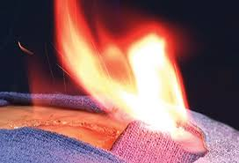
Surgical Site Fires
~65 million hospital & ASC surgeries¹
Estimated 200 – 240 surgery fires per year
Varying severity
30 Serious
Fire sites²:
On patient
44% head/neck/upper chest
26 % elsewhere
In patient
21% airway
8% other

Slide 38
Surgical Site Fires
70% - 84% occurred in oxygen-enriched environment²
Ignition Source²:
70% electrosurgical equipment
10% lasers
Fuel
ABHR 4%
1. Clarke JR, Bruley ME. Surgical fires: Trends associated with prevention efforts. Pennsylvania Patient Safety Advisory 2012 Dec; 9(2): 130-5. [cited 2012 Dec 12]. http://patientsafetyauthority.org/ADVISORIES/AdvisoryLibrary/2012/Dec;9(4)/Pages/130.aspx
2. Health Devices Oct 2009 www.ecri.org/surgical_fires

Slide 39
Survey Process Changes
Document Review Changes

Slide 40
Survey Process Changes (Cont.)

Slide 41
Survey Preparation and Documentation
Get Organized!
Ligature Risks
Complete Documentation, don’t give a surveyor a reason to ask a question!
Don’t Provide More Than Requested

Slide 42
Documentation Review
A surveyor may issue an “IOU” for documentation that is not ready at the time requested however you will be required to produce by end of day, at the latest.

Slide 43
EC 02.04.01 EP 2 High Risk Equipment
The hospital identifies high-risk medical equipment on the inventory for which there is a risk of serious injury or death to a patient or staff member should the equipment fail. D Note: High-risk medical equipment includes life-support equipment.

Slide 44
High Risk Medical Equipment
Heart Lung Machine
Ventilators
Defibrillators
Robotic assistive devices

Slide 45
Power Strips EC 02.05.01 EP 23
NFPA 99-2012, 10.2.3.6 Multiple Outlet Connection. Two or more power receptacles supplied by a flexible cord shall be permitted to be used to supply power to plug-connected components of a movable equipment assembly that is rack-, table-, pedestal-, or cartmounted, provided that all of the following conditions are met:
The receptacles are permanently attached to the equipment assembly.
(2)*The sum of the ampacity of all appliances connected to the outlets does not exceed 75 percent of the ampacity of the flexible cord supplying the outlets.
Notes:
No longer scored under medical equipment

Slide 46
Power Strips…Continued
(3) The ampacity of the flexible cord is in accordance with NFPA 70, National Electrical Code.
(4)*The electrical and mechanical integrity of the assembly is regularly verified and documented.
(5)*Means are employed to ensure that additional devices or nonmedical equipment cannot be connected to the multiple outlet extension cord after leakage currents have been verified as safe.

Slide 47
Sentinel Event Alerts
18 out of 58 impact the environment of care, including:
#9: Infant Abductions
#15: Infusion Pumps
#22: Preventing needle stick and sharps injuries
#37: Emergency electrical power system failures
#39: Preventing surgical fires
#45: Violence in the health care setting, updated February 2017
#47: Radiation risks of diagnostic imaging
#50: Medical device alarm safety
#55: Preventing falls and fall-related injuries in health care
facilities
#56: Detecting and treating suicide ideation in all settings
Notes:
Focus on medical equipment

Slide 48
Evidence of Standards Compliance (ESC)
When responding to a finding the ESC must:
Indicate the issue that is being corrected is in accordance with the finding
Indicate that this issue has been corrected
Demonstrate how compliance will be maintained
If the finding was about a periodic task that has not been completed, show that the task has been completed

Slide 49
Evidence of Standards Compliance (ESC)
For example, if a medical device(s) were found not inspected the month prior to survey. Show that the inspection period has been restarted since survey with 100 compliance. Many orgs state that they “will” ensure that the inspections are completed but not that they have occurred.
Notes:
Provide example of glucose monitors that were not inspected biweekly. The organization hired a new nurse leader that instituted a policy that all monitors will be inspected. Policy circulated to staff but org does not attest the taks has been completed.

Slide 50
Q. Device Inventory
What is the possibility of getting a complete medical device inventory from a JCAHO audit [TJC survey]?
How often are JCAHO audits [TJC surveys] required?

Slide 51
A. Device Inventory
The Joint Commission does not manage or facilitate your medical device inventory. The inventory could be centralized or distributed
Surveys are triennial events.

Slide 52
Q. Cybersecurity
What are The Joint Commission's plans with regards to cybersecurity as it relates to patient safety, privacy, care delivery, the business of healthcare, etc.?
Any plans to establish specific requirements in the future or to clarify existing requirements with regards to cybersecurity?
Will TJC update the requirements for MEMP to include data protection, availability, or other Cybersecurity elements?

Slide 53
A. Cybersecurity
The current IT Chapter requires business continuity to be managed by the organization, so the Joint Commission currently has no plans to develop additional standards addressing cybersecurity

Slide 54
Q. User/Service Manual EP (EC.01.01.01 EP 3)
How is JC going to measure the user / service manual standard ?
EC.01.01.01 EP 3: the hospital has a library of information regarding inspection, testing, and maintenance of its systems.
NOTE: This library includes manuals, procedures provided by manufactures, technical bulletins, and other information.

Slide 55
A. User/Service Manual EP (EC.01.01.01 EP 3)
The intent was to assist the HTM in requesting manuals, tech docs, etc. from the manufacturer.
The surveyor simply will ask if you have a library of appropriate materials (electronic or hard copy is fine) and where are they.

Slide 57
SIG - Department of Engineering
Herman A. McKenzie, MBA, CHSP
Director
Andrea Browne, PhD., DABR
Medical Physicist
Thomas J Todro, MBA, CBET
Engineer
John Raisch, CHFM
Engineer
Kenneth (Beau) Hebert, MAOM, CHSP, CHEP
Engineer
Notes:
57

Slide 58
The Joint Commission Disclaimer
These slides are current as of 09/28/2019. The Joint Commission reserves the right to change the content of the information, as appropriate.
These slides are only meant to be cue points, which were expounded upon verbally by the original presenter and are not meant to be comprehensive statements of standards interpretation or represent all the content of the presentation. Thus, care should be exercised in interpreting Joint Commission requirements based solely on the content of these slides.
These slides are copyrighted and may not be further used, shared or distributed without permission of The Joint Commission. Distribution of the speaker’s presentation other than in PDF format is expressly prohibited.

